Slide 1

Cadbury Diapers
Why this topic?
In 2022, India stands top 3 in global baby diapers market so there is a great demand for diapers in India. Also there is no dominant competitor for diaper market in India.
TEAM : TEAM PHOENIX
MEMBERS : RUCHITA & NAVYA
COLLEGE NAME : IIT (ISM) DHANBAD

Slide 2












We are Introducing a new idea to diapers with Cadbury Fragrances!
Say goodbye to stinky diaper moments and hello to breath of various Cadbury fragrances. Experience the confidence of knowing that even the messiest diaper changes can be a refreshing experience. We came up with different fragrance choices to the customers liking such as chocolate, strawberry, vanilla, caramel fragrances and so on.
TAGLINE : fragrance hugs your baby
PLATFORMS
TARGET AUDIENCE :
GEOGRAPHIC : urban regions in India.
Age : parents of children aging 0-3years.
PSYCHOGRAPHIC : people buying Cadbury products.
Income : lower, middle and upper classes.
Reason:
these platforms are the best online selling sites in India for startups also have the highest audience reach ​

Slide 3
 | Strategies | Reasons
Before launch | - creating coming soon page -SEO with easy to find FAQs -Invest in influencer created content -creating guest blog posts -email marketing contents -social media ads | -Instagram and Facebook posts -Format - 1080 x 1350px -Frequency - 3 times per week -Creating brand awareness -getting ideas from audience to tailor the product through them.
During launch | - tweet about product launch in twitter - Instagram giveaway and ad posts - website housekeeping - hosting Q&A sessions through Facebook live streaming -video content in suitable platforms. -brand story telling through content and videos. -leverage social proof through customer reviews. -Customer engagement activities like quizzes, games. | -Instagram post (portrait) -Format - 1080 x 1350px -Frequency – 2 times per week -It can be used in fb, Pinterest posts -Adding benefits to the customers to drive sales -website loading speed ensures better UX
After launch | -Highlighting success stories and case studies of customers -review and respond to feedback -ongoing support and resources such as user guides, video tutorials. -articles about industry insights, tips and tricks -social media ads | -User guide infographics -Format – 800 x 2000px -Frequency – 2 times per week - Analyzing data can give accurate judgements on product marketing.

Slide 4
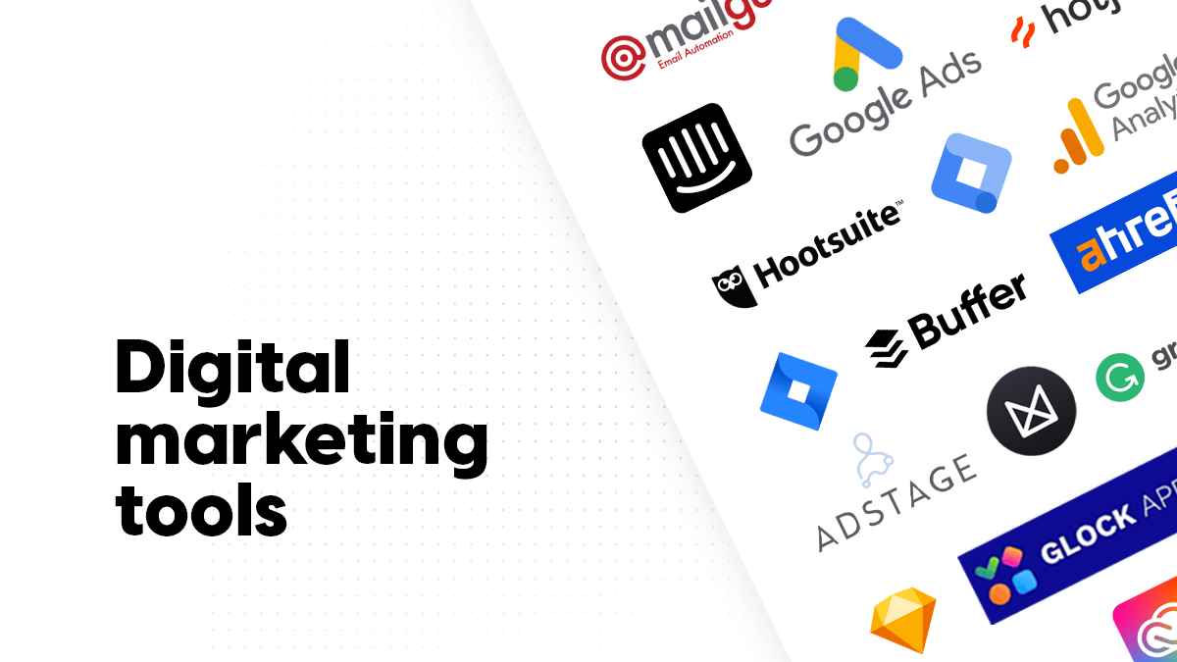
 | TOOLS USED | REASON
Content Creation and Design | Canva and Figma | For creating content and flyers
Social Media Management and Scheduling | Hootsuite and Buffer | for managing and scheduling social media posts across multiple networks
SEO | Google keyword planner, google page speed insights | Free tool helps in keyword research, page speed
Email Marketing | Mailchimp | For designing, sending, and tracking email campaigns.
Analytics and Tracking | Google Analytics | For detailed insights into website traffic, user behaviour, conversions, and more.
Project Management and Collaboration | Trello | To uses boards, lists, and cards to manage projects and workflows.

Slide 5
COLLABORATIONS
REVENUE GENERATION STRATEGIES
Combo of mamaearth baby products with diapers
with Gpay which can give our brand coupons for target audience.
Introducing limited edition diapers with famous cartoon characters in collaboration with D-mart.
with famous kid influencer
with bio-material producer to manufacture degradable diapers.
with recycling company to recycle diapers.
with an NGO organisation to supply free diapers for needy people.
Partnership and sponsorship:
sponsorship opportunities for events such as baby expos, parenting workshops, or community events and Collaboration with parenting influencers, mommy bloggers to reach a wider audience.
2. Complementary product for mega diaper pack with wipes.
3. Distribution and Retail Partnerships:
Offer attractive wholesale terms to incentivize retailers to carry the product, such as volume discounts or cooperative marketing initiatives.
4. Loyalty programs:
to reward repeat customers with discounts, exclusive promotions.
KEY METRICS
CONTENT TRANSFORMATION
Website Bounce rate
Monthly revenue changes
ROI & ROIS
leads generated.
Customer life time value
Conversion rate
Avg profit margin
Total revenue generated
Product Updates and Announcements
Content for Loyalty Programs and Rewards
Customer Support and FAQs
User-generated Content
Content for Cross-selling and Upselling
Customer Success Stories and Testimonials
Feedback and Reviews Integration

